Slide 1
CLIMATE CHANGE

Slide 2
DATA
We get the data from the website in the excel format.
We start cleaning the data.
We remove the null values and blanks in the given data.

Slide 3
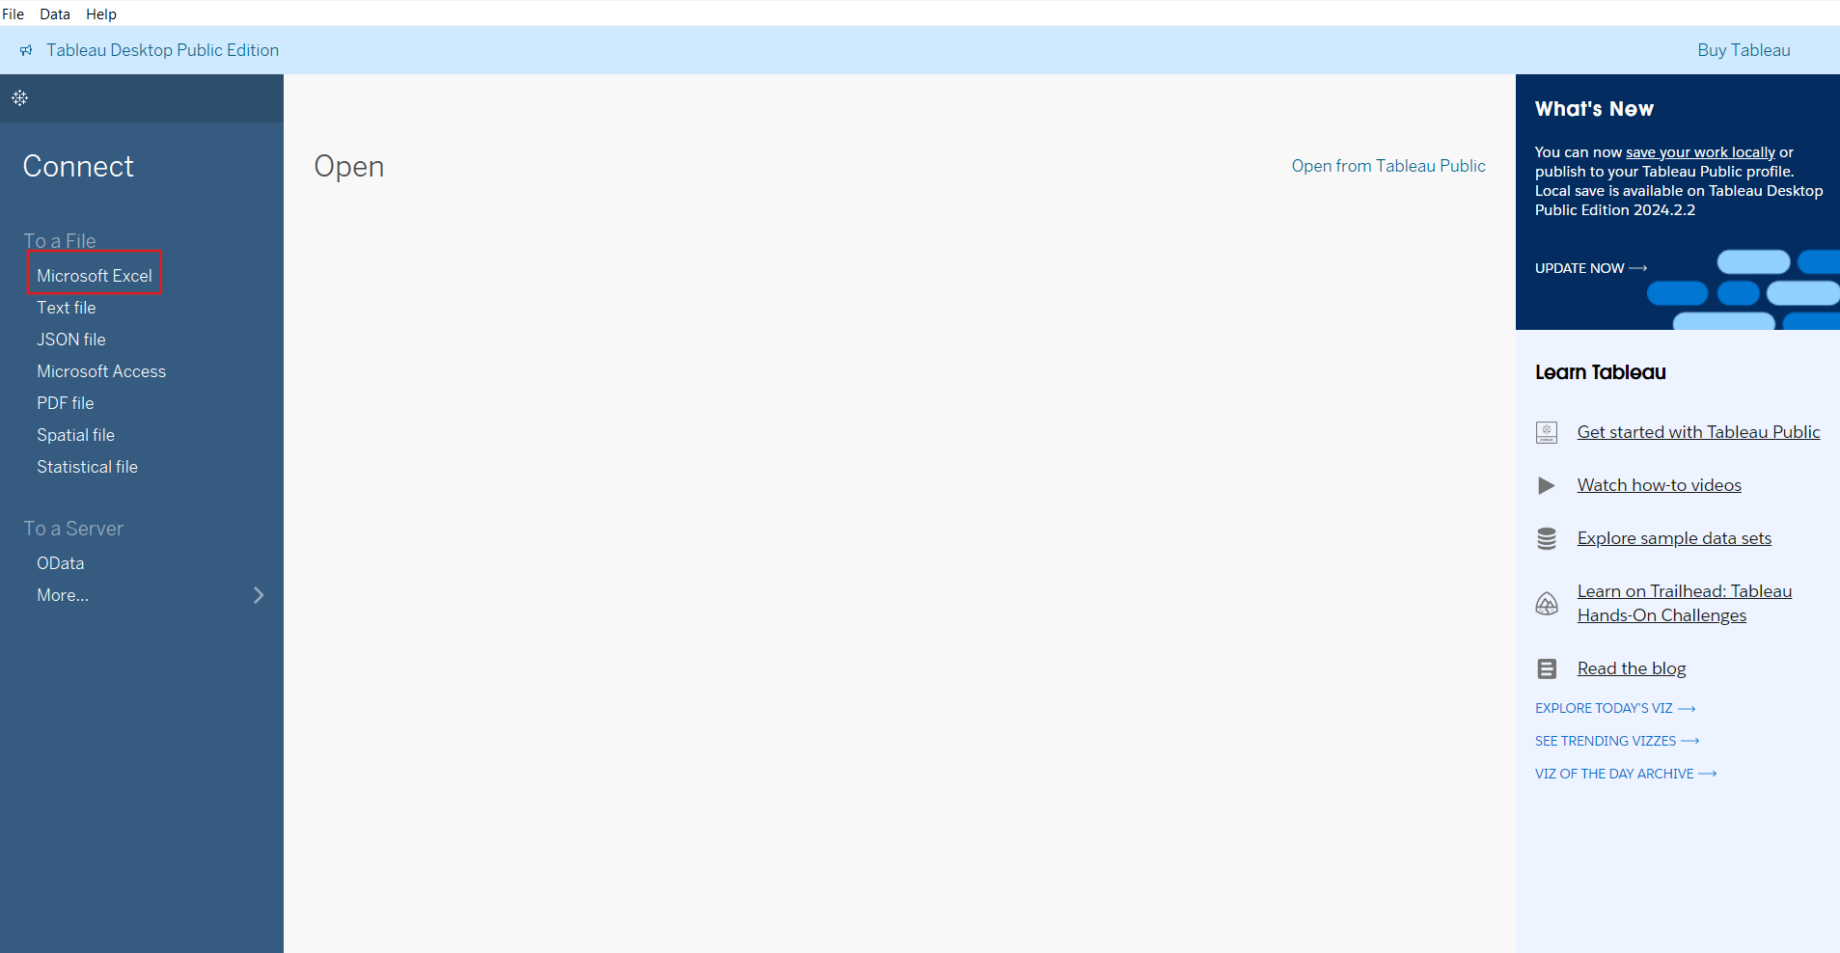
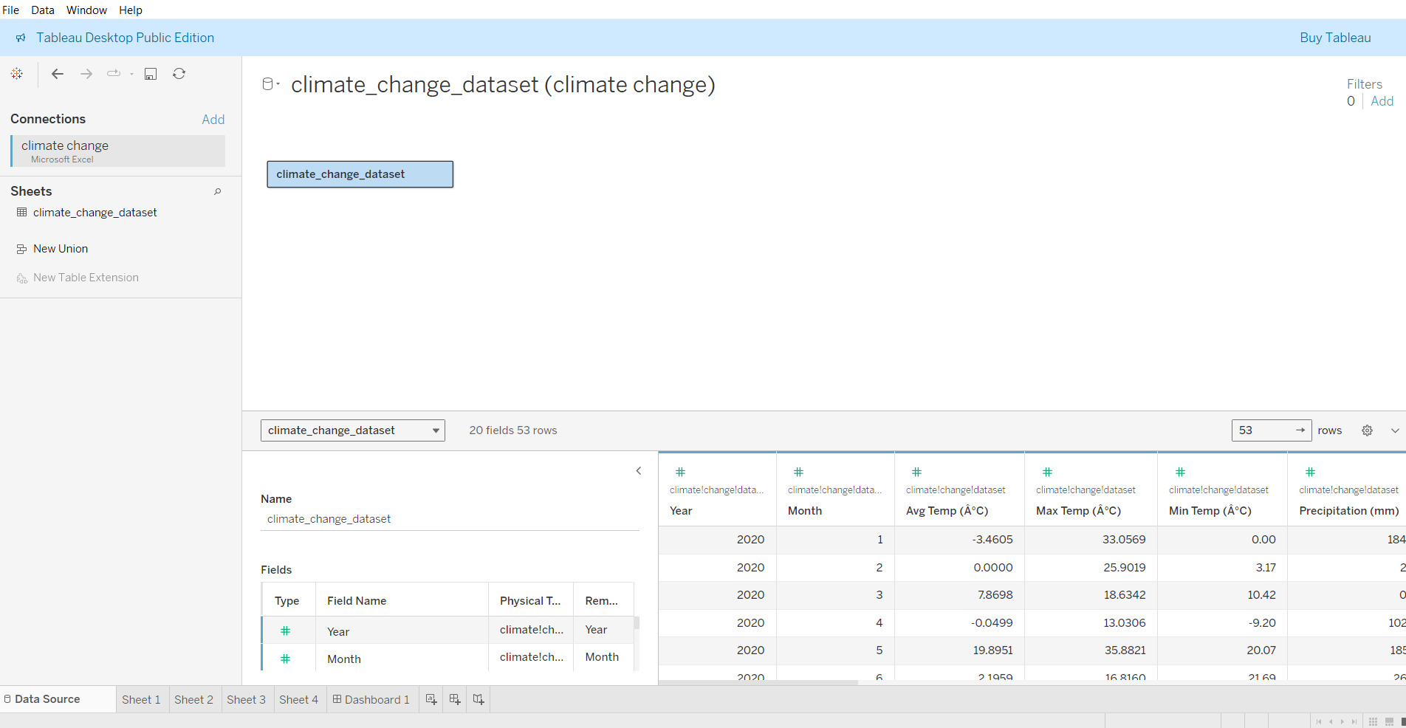
IMPORT FILE
Open tableau and click Microsoft excel.
Select the file and click ok.
The dataset will open.
Next we click on sheet 1.

Slide 4
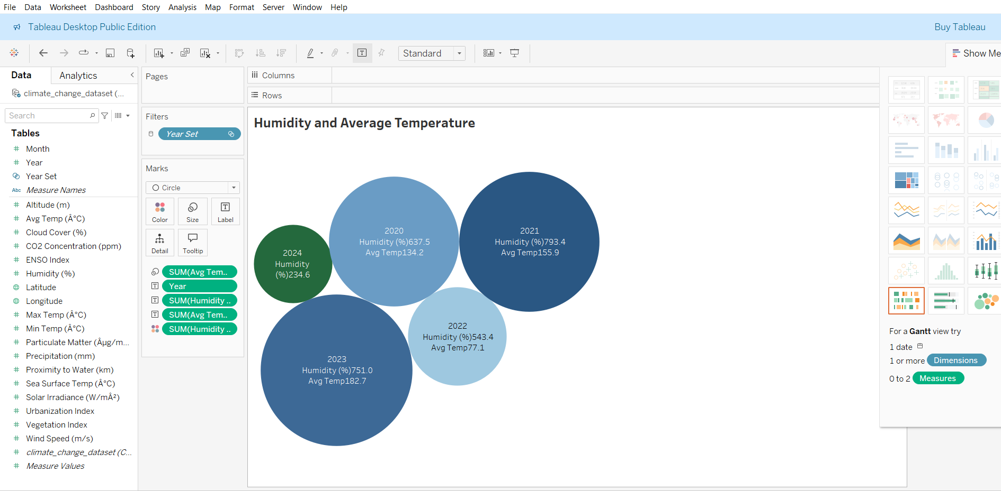
HUMIDITY AND AVERAGE TEMPERATURE
Here, the worksheet is opened.
Here, can change the size, color, and labels.
We can click the circle visualization.
In this visualization Humidity and Average Temperature for the years are shown.

Slide 5
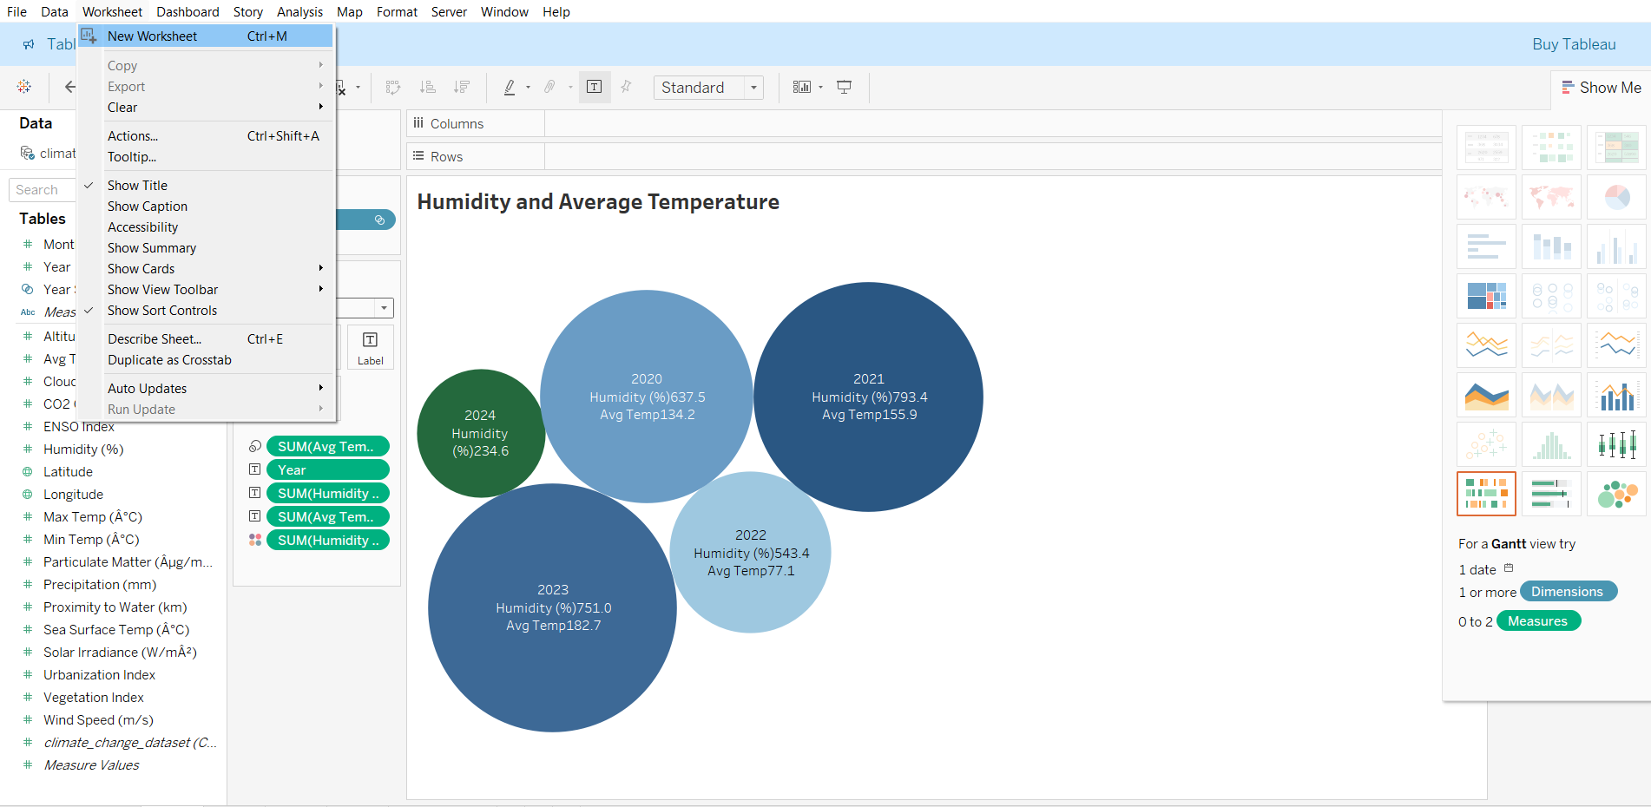
NEW WORKSHEET
Next, we create the new worksheet.
Click worksheet → new worksheet.

Slide 6
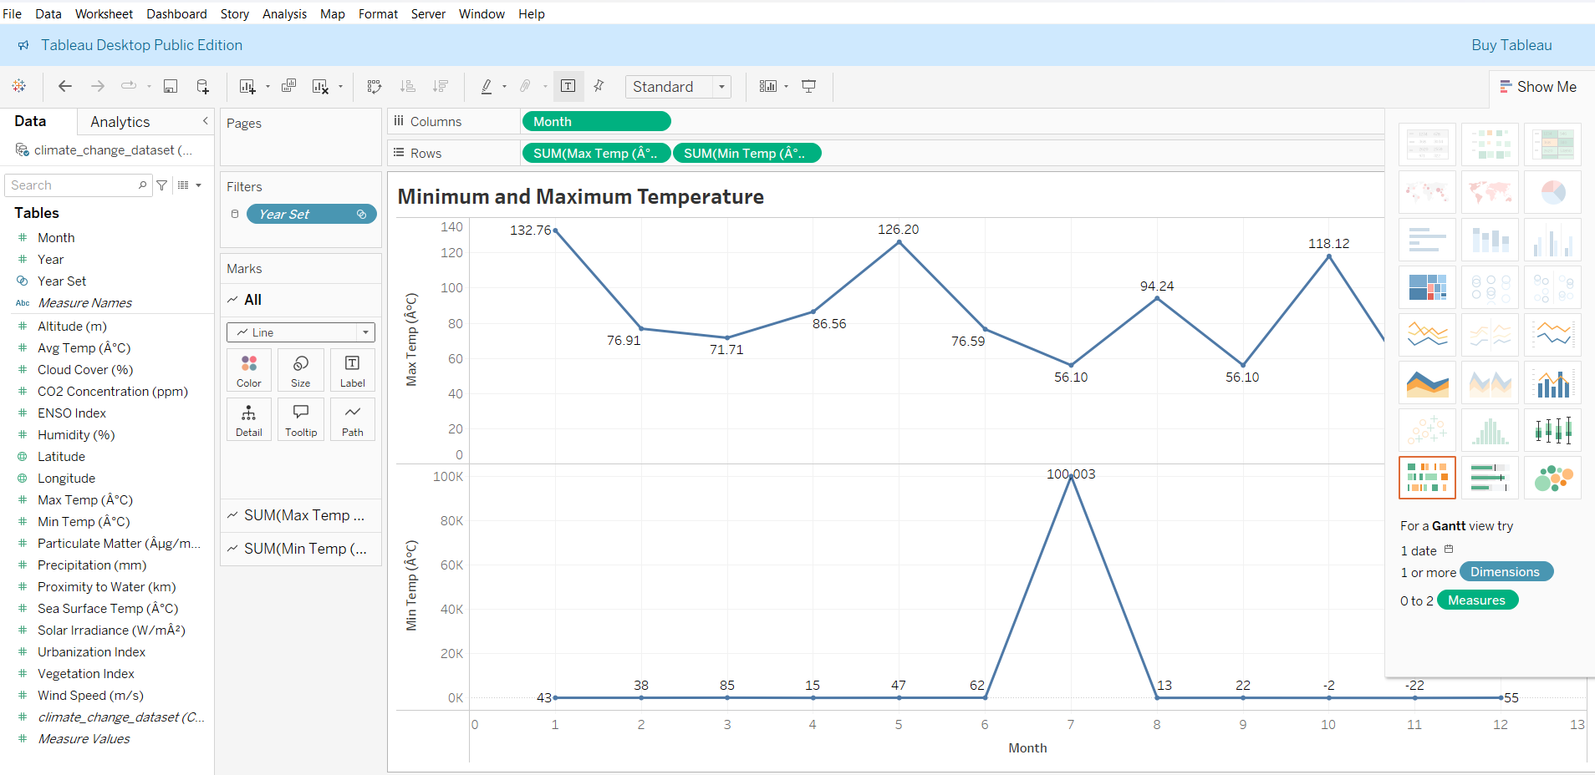
MINIMUM AND MAXIMUM TEMPERATURE
Here, we visualize minimum and maximum temperature for every month.
We click the line chart.
Drag month in the column and maximum, minimum temperature in rows.
We can change the size, color, and labels.

Slide 7
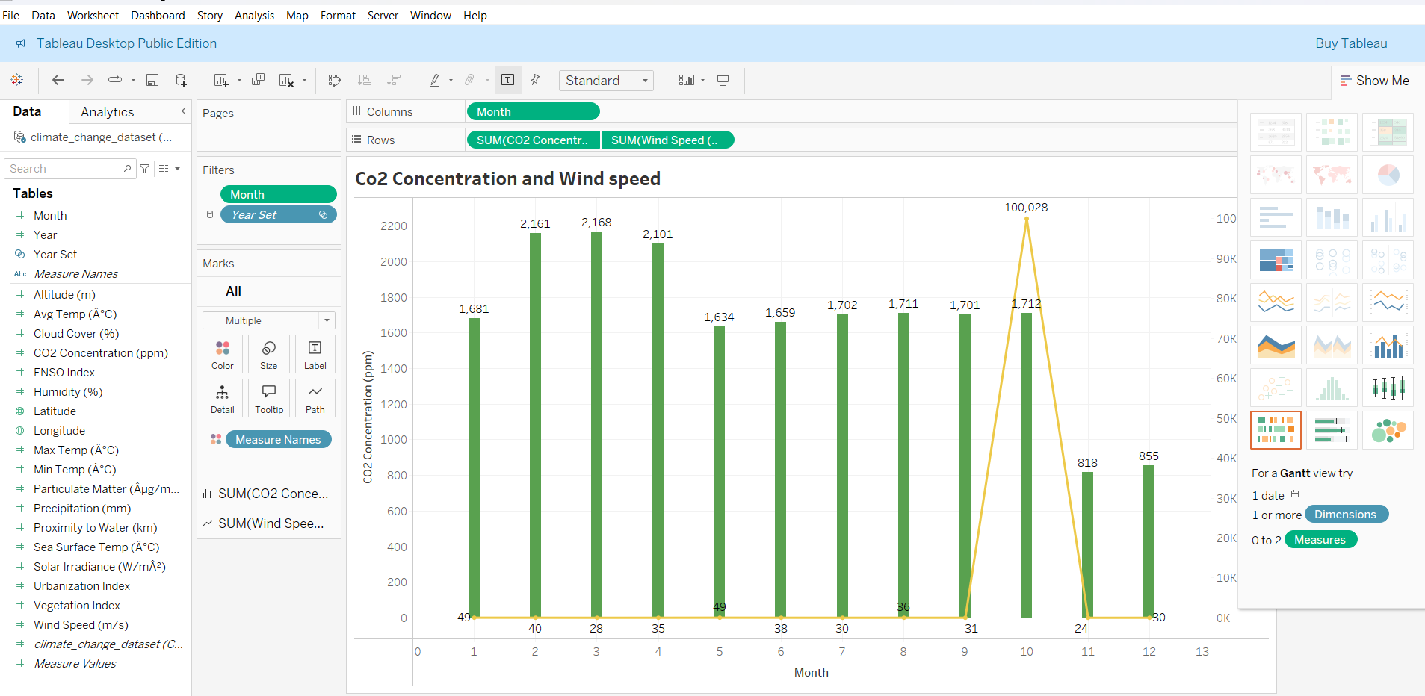
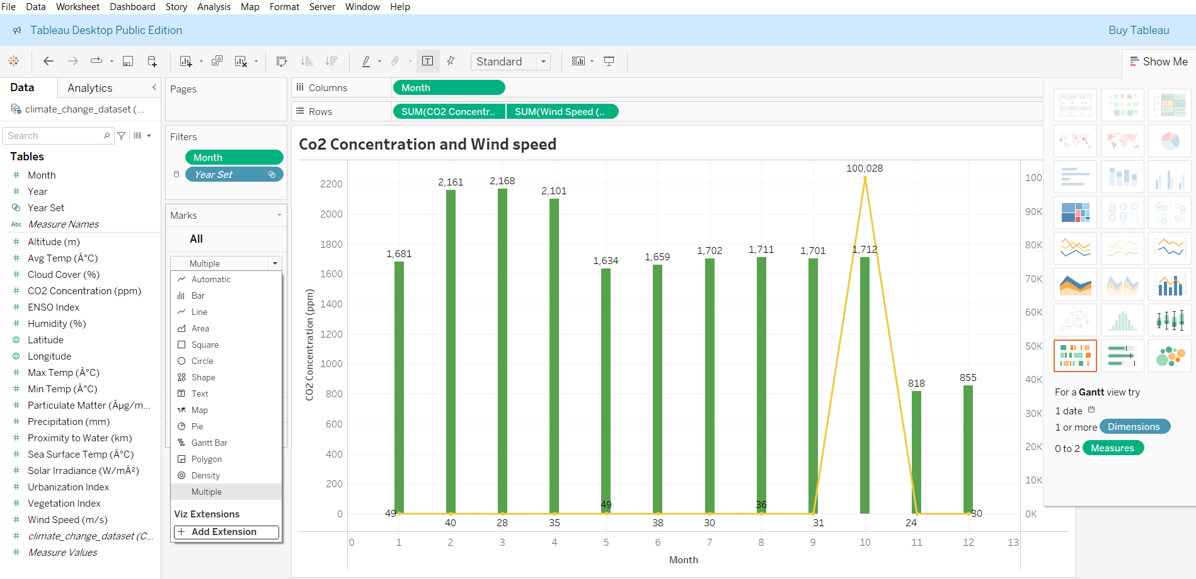
CO2 CONCENTRATION AND WIND SPEED
Again create a new worksheet and create a new visualization.
Drag month in the column and Co2 concentration, Wind speed in rows.
We click the multiple chart.
We can change the size, color, and labels and axis.

Slide 8
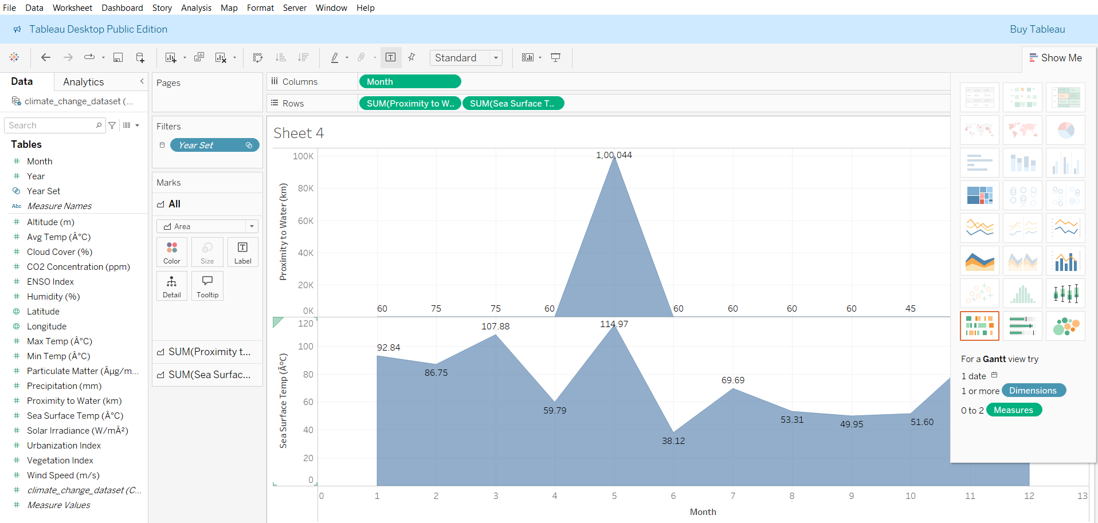
PROXIMITY TO WATER AND SEA SURFACE TEMPERATURE
Next, we visualize proximity to water and sea surface temperature.
Drag month in the column and proximity to water, sea surface temperature in rows.
Here, we select area chart.

Slide 9
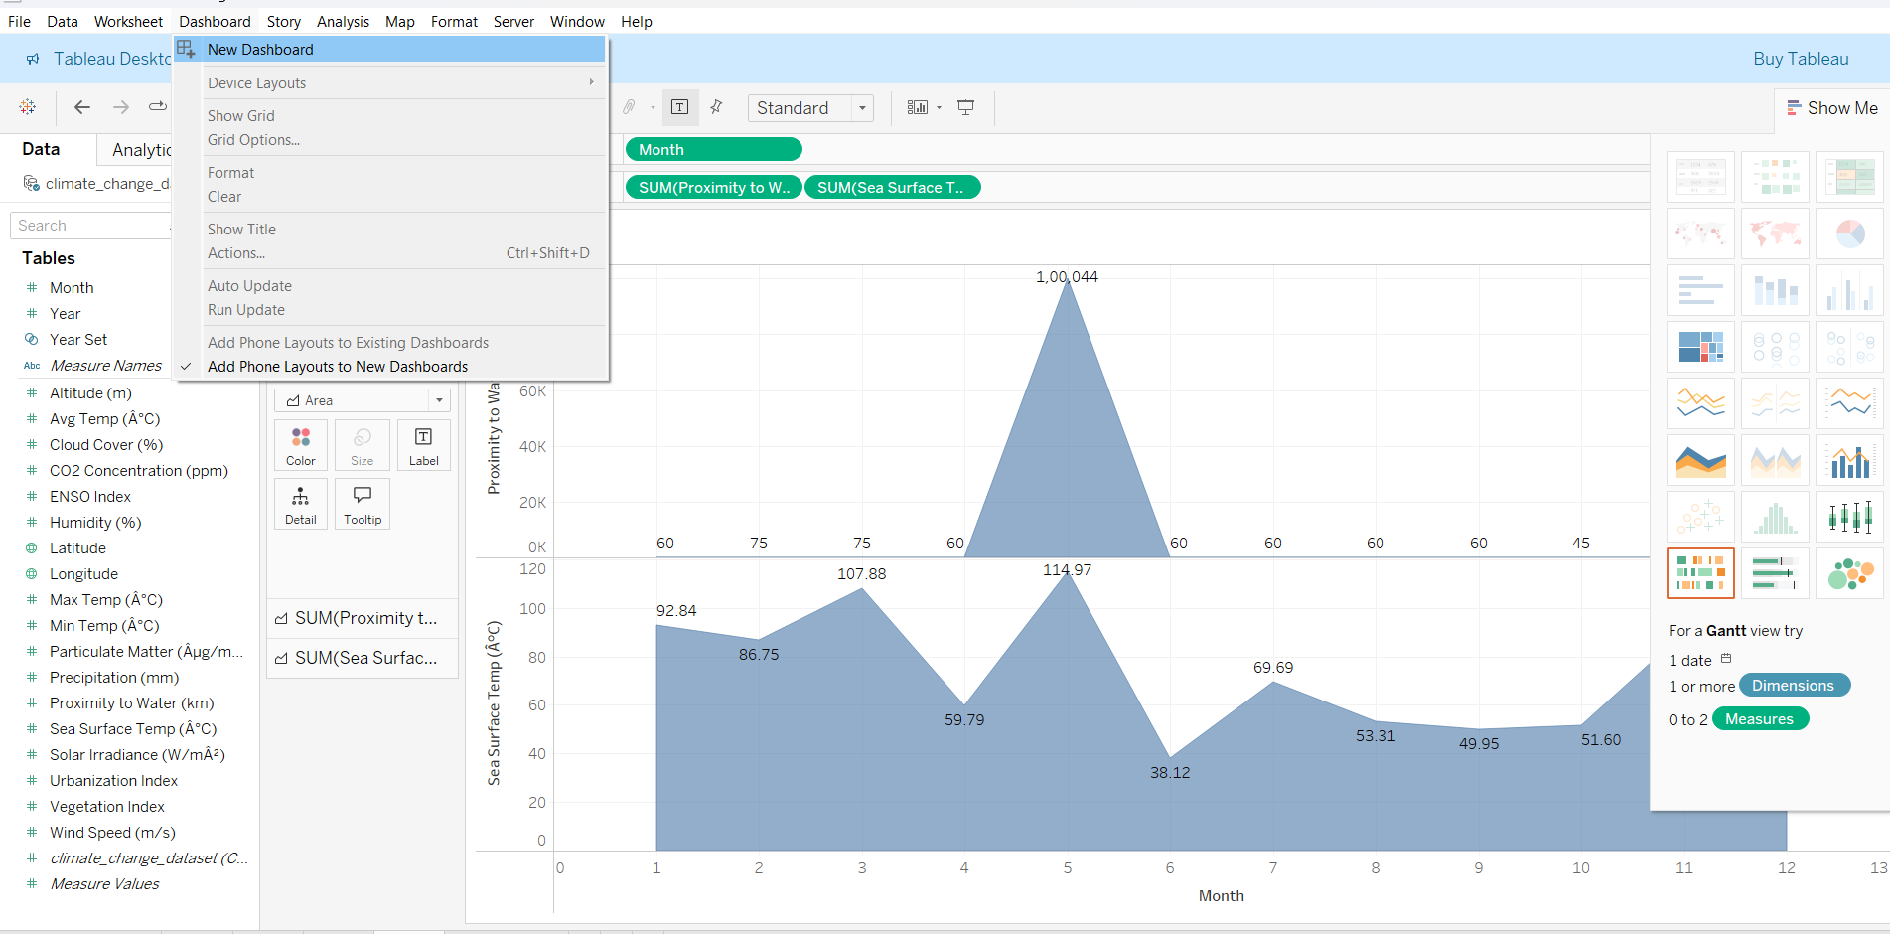
NEW DASHBOARD
Now, we create dashboard.
Click dashboard → new dashboard.

Slide 10
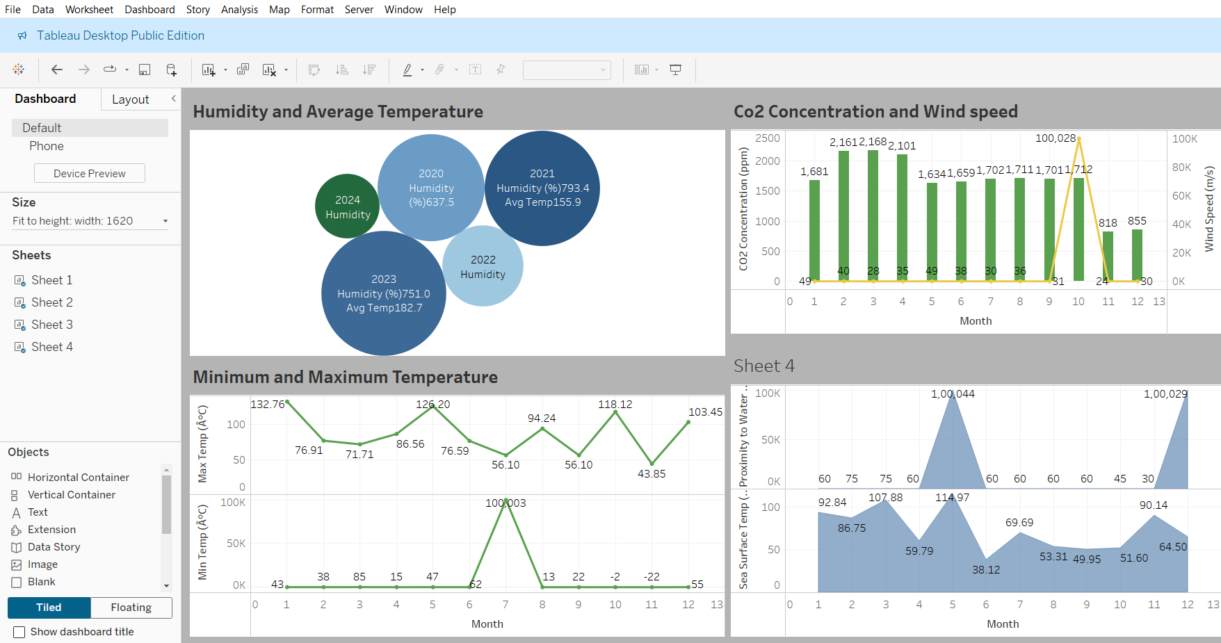
CREATING DASHBOARD
Now, we drag all the worksheets in the dashboard.
Also we change the title of each visualization.

Slide 11
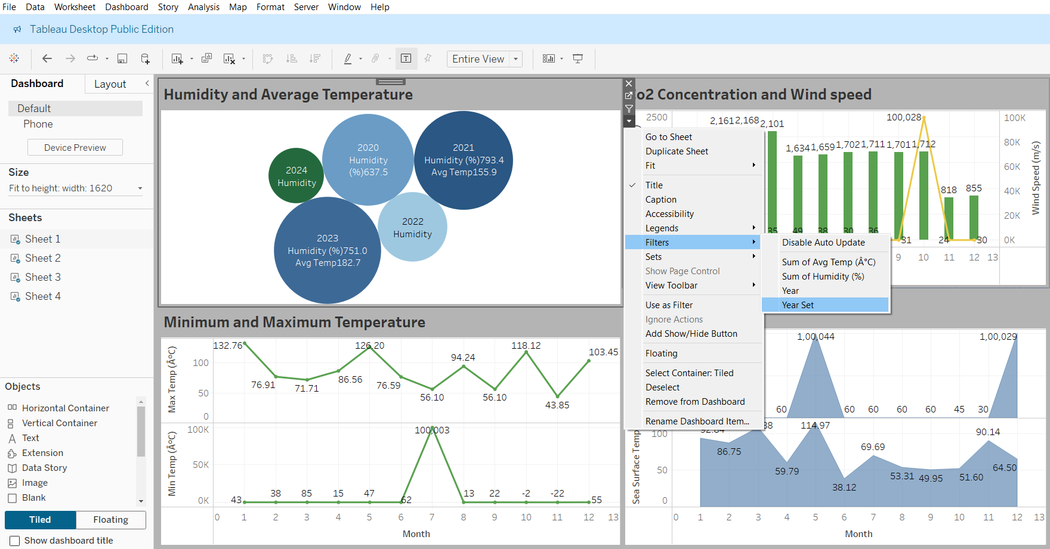
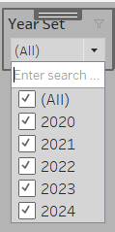
FILTER
Next, we create a filter for the visualization.
Click any one of the visualization in the dashboard.
Click dropdown arrow → Filters → Year set.

Slide 12
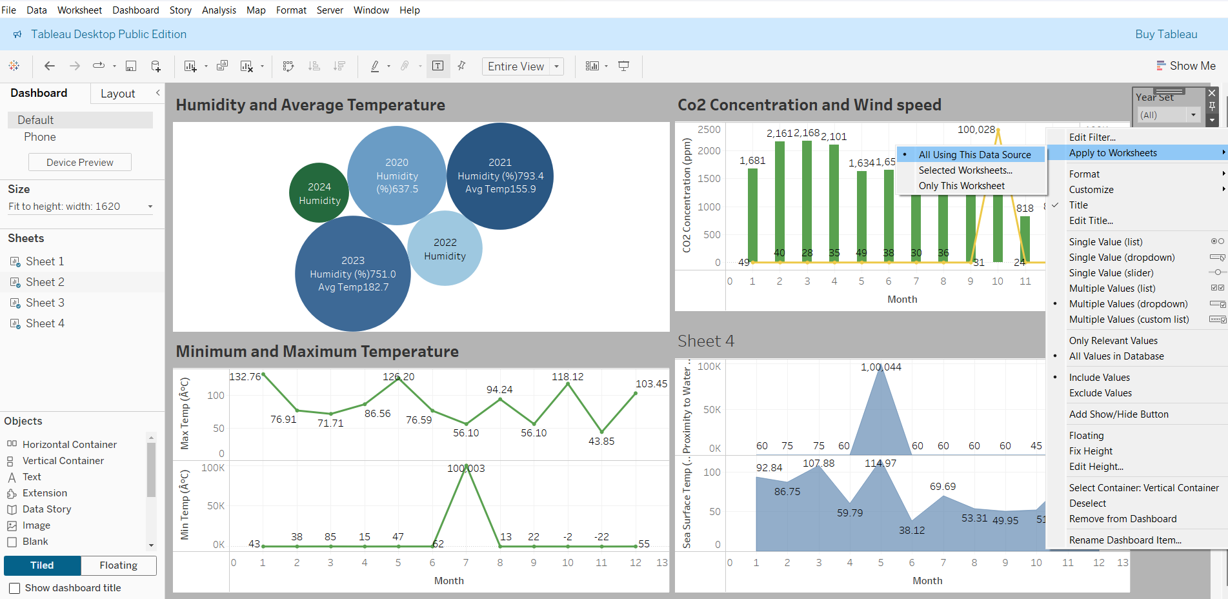
Next, click dropdown in filters → apply to worksheets → all using this data source.
So that this filter can be used in all the visualizations in the dashboard.

Slide 13
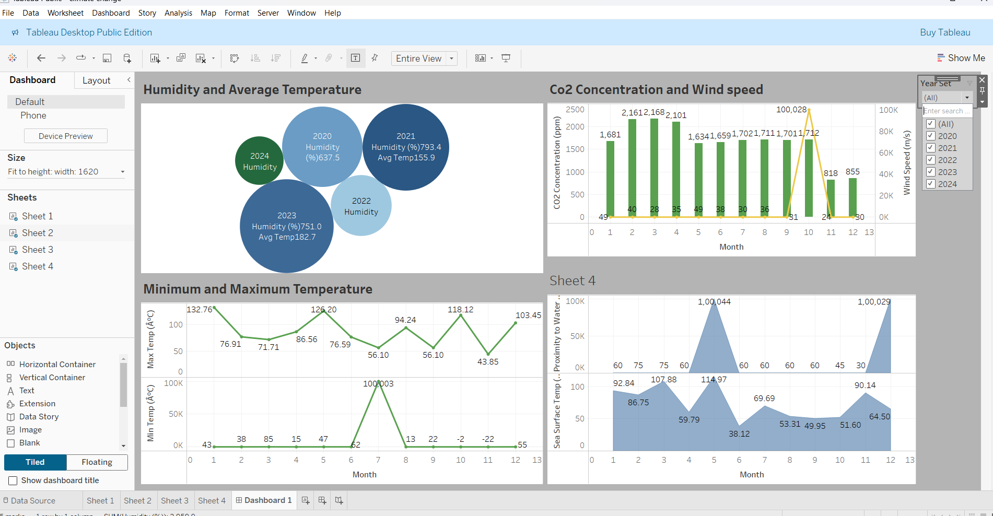
DASHBOARD
We got the dashboard of climate change visualization.

Slide 14
THANK YOU!

